Slide 1
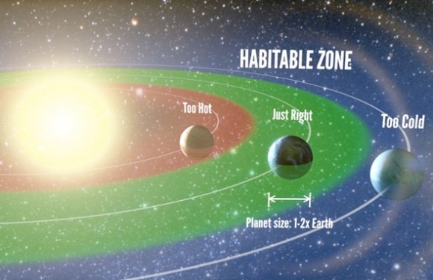
Chemistry
of Planetary
Atmospheres
Perspectives &
Prospects
Yuk Ling Yung (翁玉林 ）Caltech
2016 Oct 24 Lecture 1 PKU

Slide 2
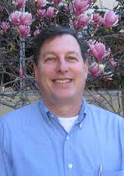

Comprehensive
Chemical Model: KINETICS
1200 Species
20,000 reactions
Coupled to aerosol microphysics
Coupled to 1-D and 2-D transport
Applied to Solar System Planets, Earth as a Planet, Exoplanets and Planetary Evolution
More than 300 refereed publications
Allen et al. (1981), Shia, Morgan, Weibel, Willacy + Students
Mark Allen
Run-Lie Shia

Slide 3
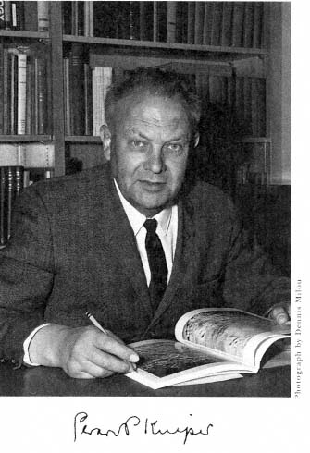
“
Terrestrial and planetary atmospheres
that they can usefully be studied as a single field, each reinforcing ideas from the other.
share so much in common
—Gerald Kuiper

Slide 4
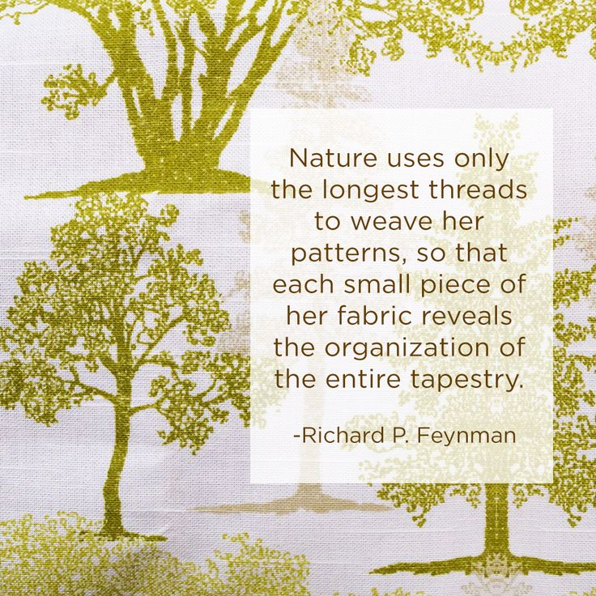
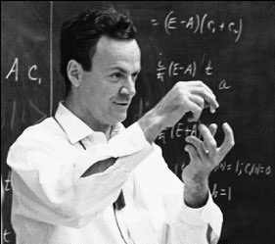

Slide 5
Today’s Outline
Introduction
Terrestrial Planets: Mars, Earth, Venus
Terrestrial Analogs: Titan, Pluto,Triton
Exoplanets and Life

Slide 6
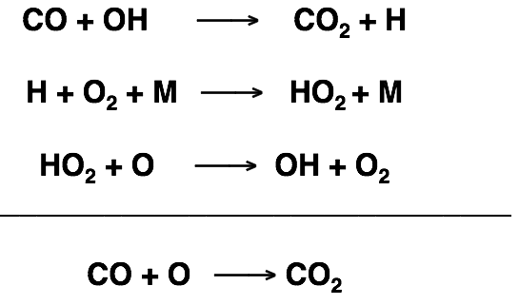

On Mars
Prof. Michael McElroy
Harvard University
CO~0.1%, H2O~10⁻⁴

Slide 7
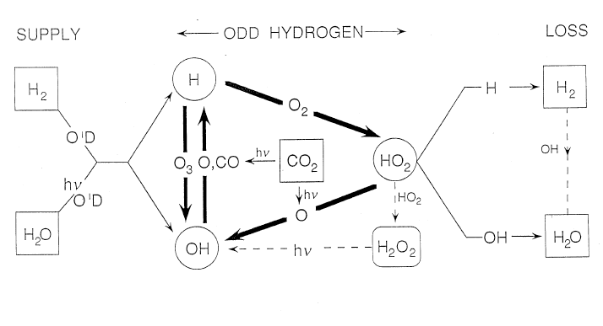
Classic Catalytic Cycles
McElroy and Donahue 1972
Parkinson and Hunten 1972
Applications to
Earth Mesosphere: Allen et al. 1981
M-Star Exomars: Tian et al. 2014; Gao et al. 2015

Slide 8
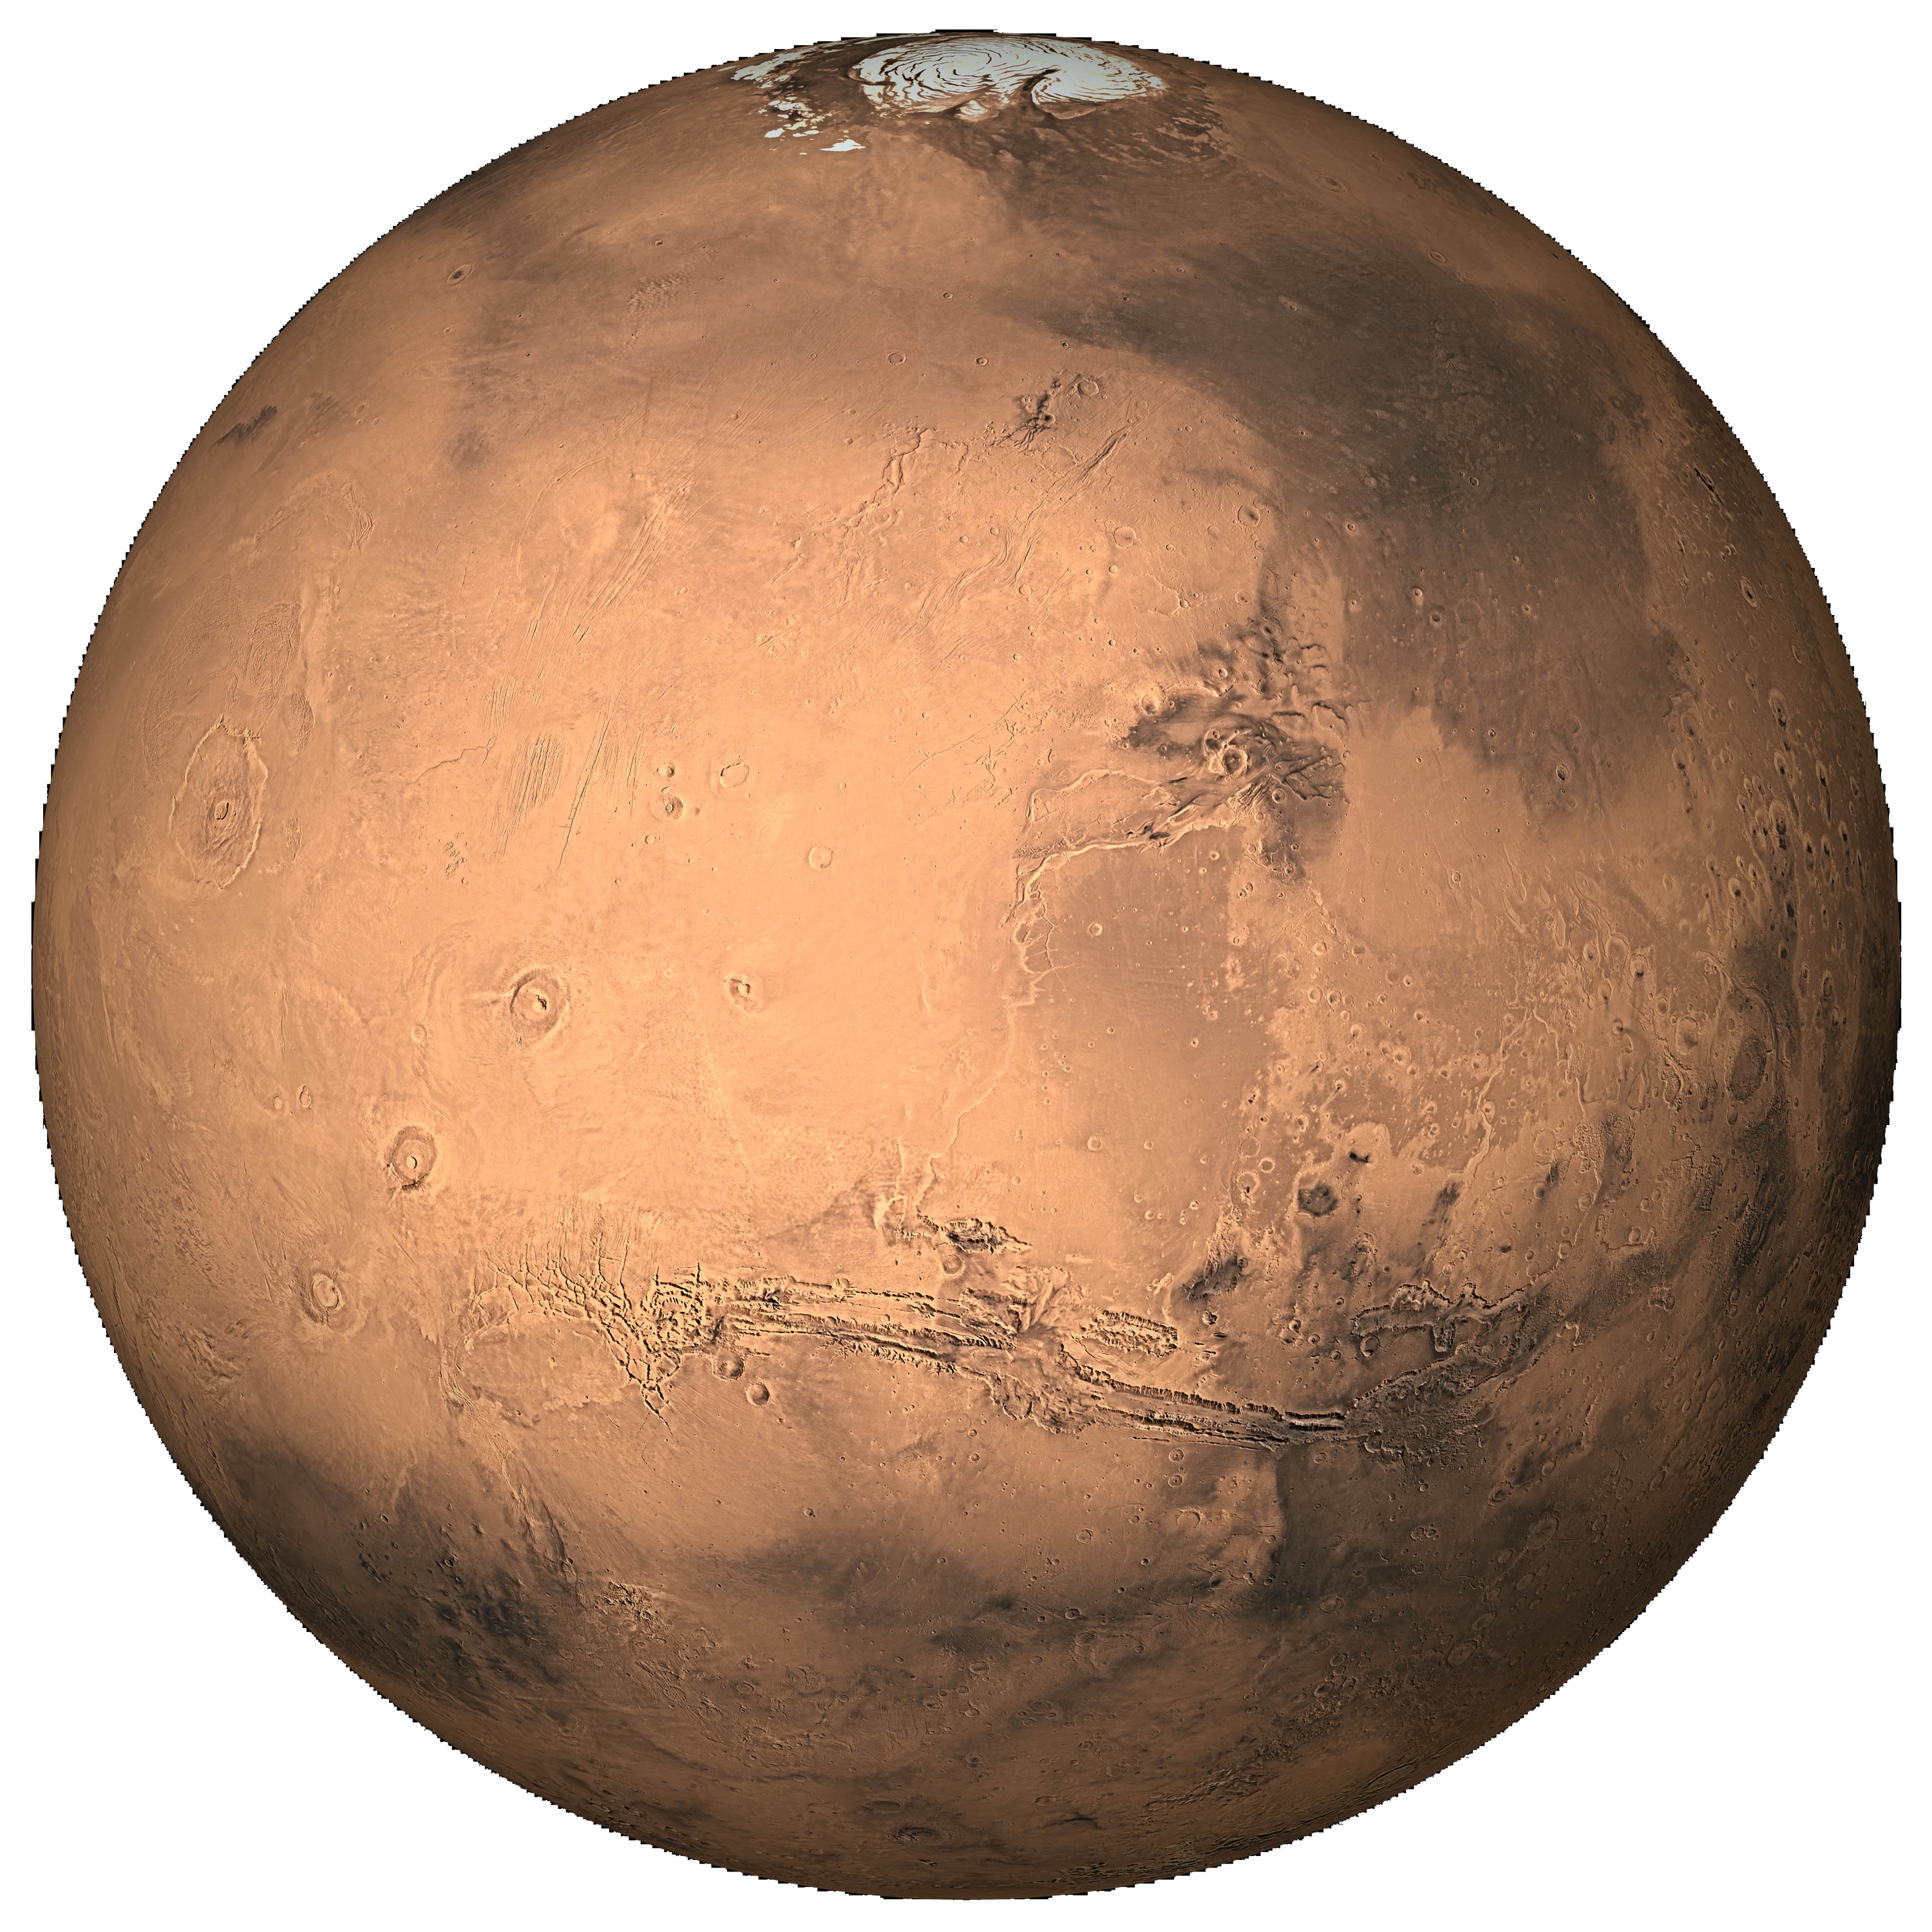
“
Everything should be made as simple as possible, but not simpler.
—Albert Einstein
The atmosphere of Mars is the hydrogen atom of planetary atmospheres.

Slide 9
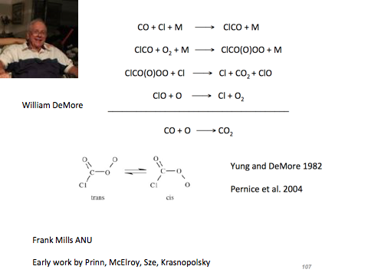
Venus
CO + Cl + M ClCO + M
ClCO + O2 + M ClC(O)OO + M
ClC(O)OO + O Cl + CO2 + O2
___________________________
CO + O CO2
Venus
CO~10⁻⁴
HCl ~10⁻⁶, Connes et. al 1967

Slide 10
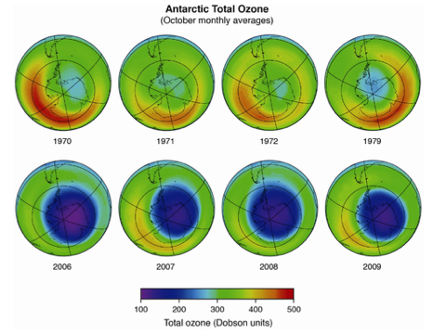
https://collidecolumn.wordpress.com/2012/09/15/when-worlds-collide-33-montreal-protocol-25-saluting-defenders-of-the-sky/

Slide 11
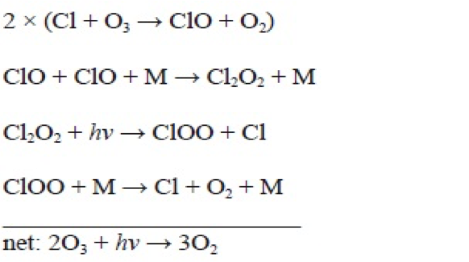
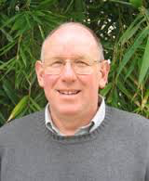

Chlorine Monoxide Dimer
2[O3 + Cl ClO + O2]
ClO + ClO + M Cl2O2 + M
Cl2O2 + hv ClOO + Cl
ClOO + M Cl + O2 + M
______________________________________
2O3 3O2
Stan Sander
O3 ~10⁻⁵
Clx ~10⁻⁹, from CFC
Sander, Friedl and Yung 1989
Solomon 1999 for Review

Slide 12
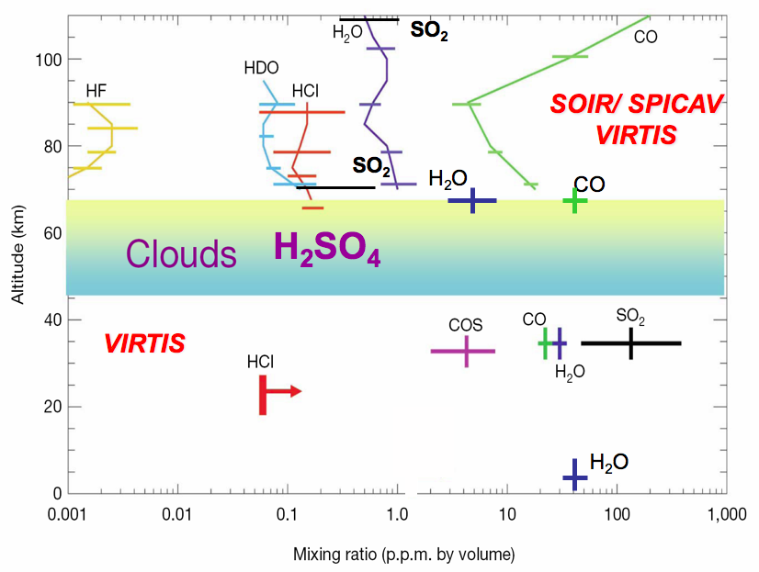
Venus Express

Slide 13
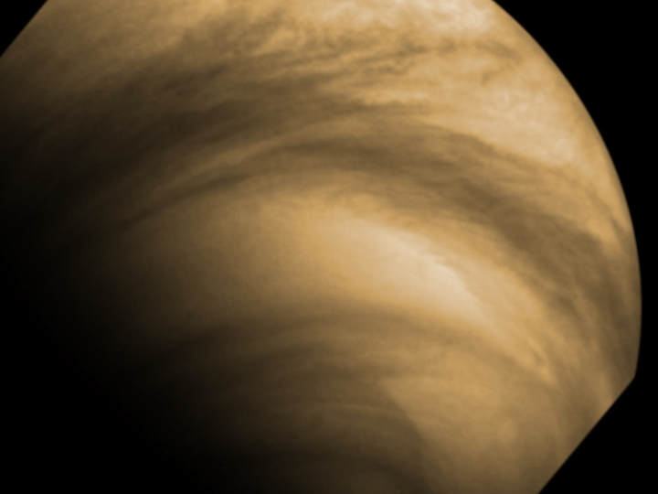

Slide 14
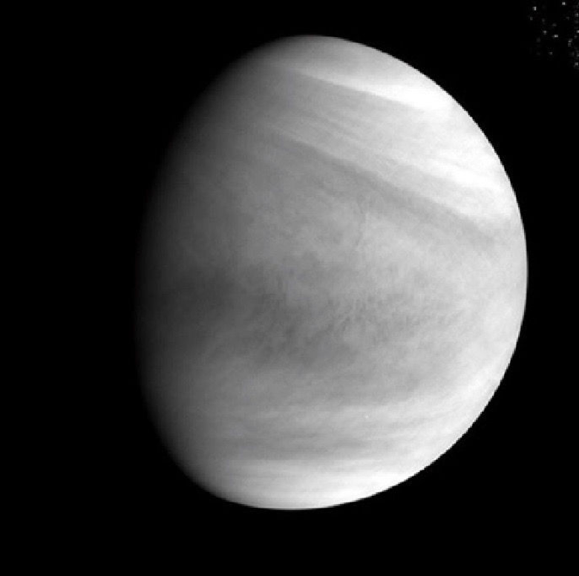
Akatsuki spacecraft's
Ultraviolet Imager
Dec. 6, 2015

Slide 15
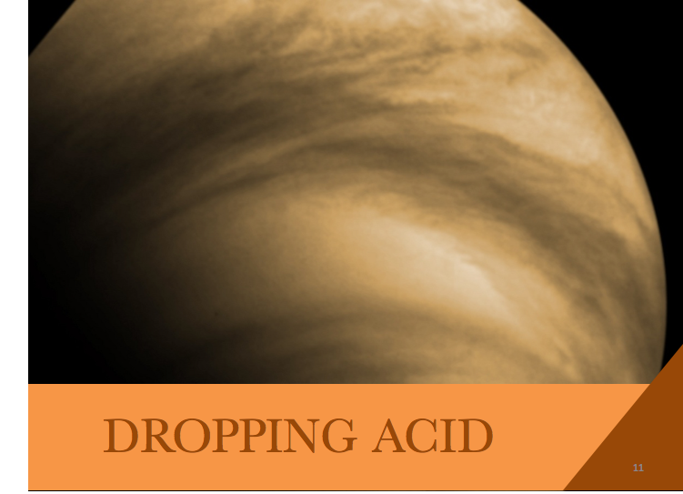

Slide 16
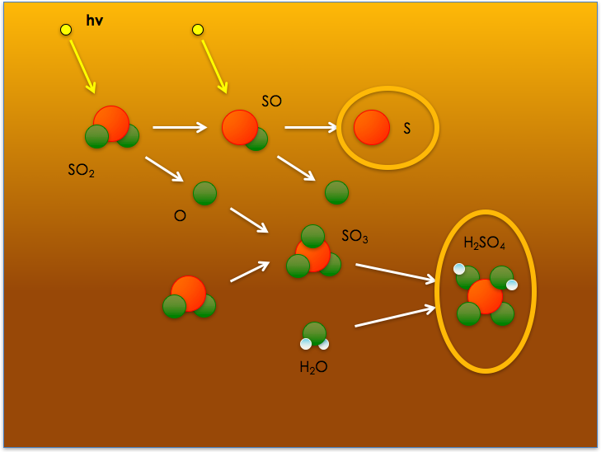

Slide 17
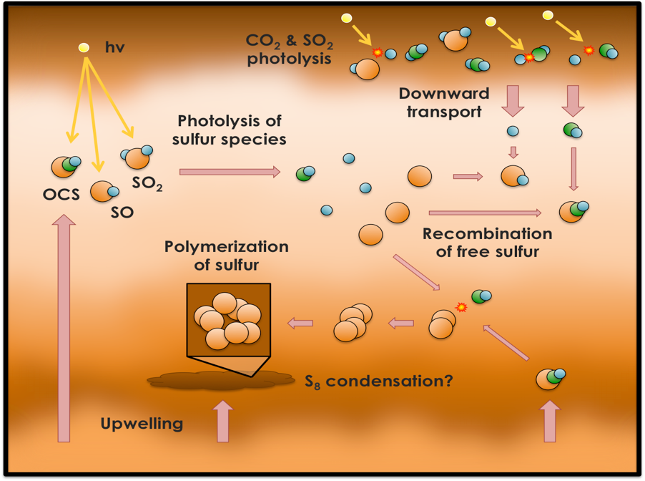
Gao 2016 Thesis

Slide 18
Outstanding Issues
  Perchlorate on Mars
  Nitrate on Mars
  Mystery UV Absorber on Venus
  Stability of Ancient CO2 atmospheres

Slide 19
Today’s Outline
Introduction
Terrestrial Planets: Mars, Earth, Venus
Terrestrial Analogs: Titan, Pluto,Triton
Exoplanets and Life

Slide 20
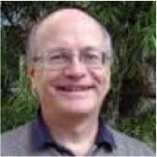
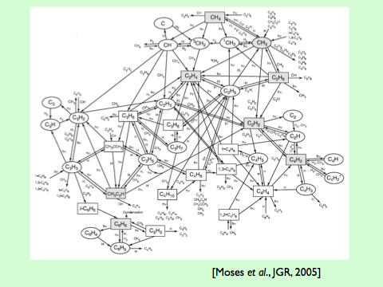

Randy Gladstone
Julie Moses
Strobel 1969, 1973
Gladstone et al. 1996
Moses et al. 2005

Slide 21
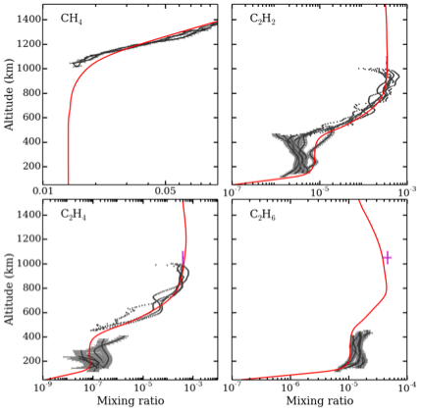

Yung et al. 1984
Li et al. 2014, 2015
Vuitton et al. 2007, 2008

Slide 22
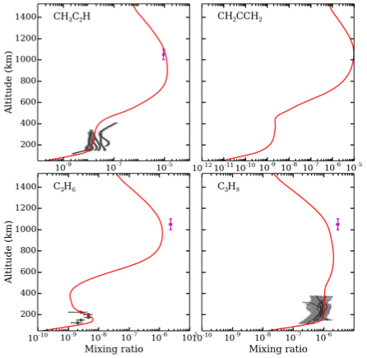
Titan is Nature’s laboratory for organic synthesis, fulfilling the vision of Urey and Miller
(1953)
However,
the emergence
of life requires
more than that.

Slide 23
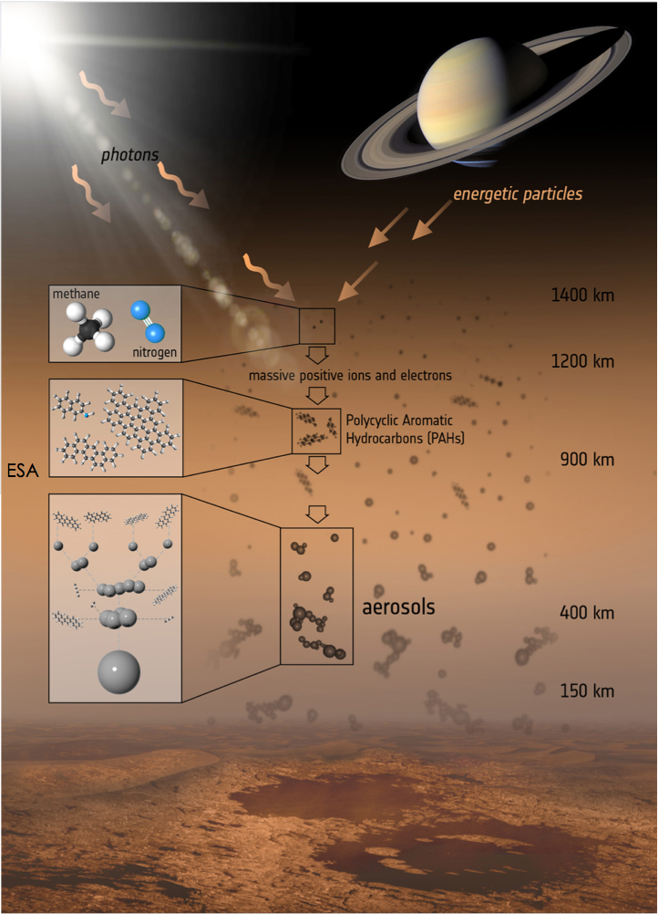

Slide 24
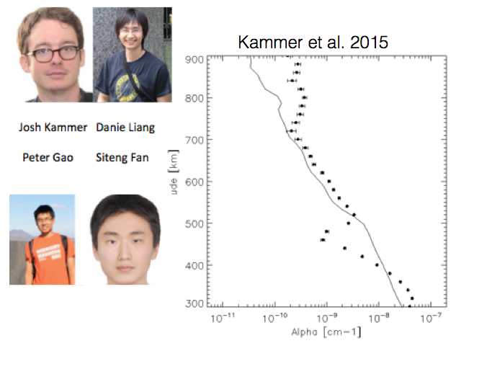
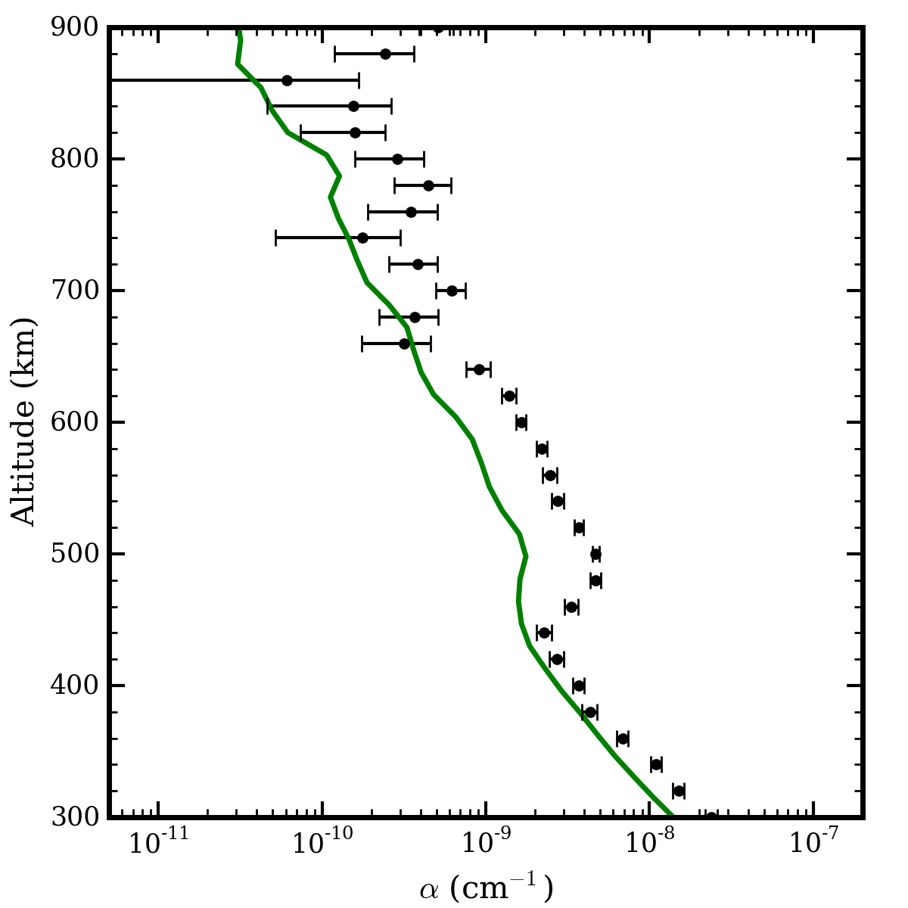


Tholins on Titan
Data: Cassini UVIS
Liang et al. 2007
Lavvas et al. 2013
Kammer, Shemansky,
Fan, Gao, Yung 2015

Slide 25
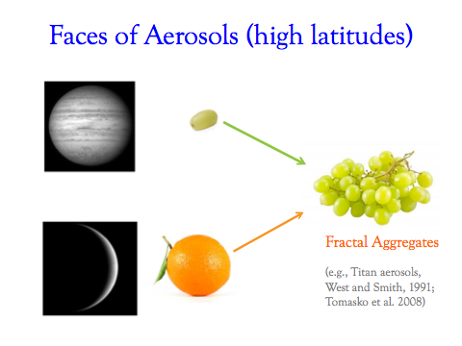
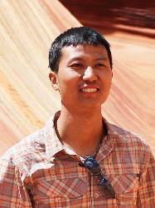
Xi (Arthur) Zhang
Zhang, West, Banfield, Yung 2013
Horst et al. 2012
Trainer et al. 2006

Slide 26
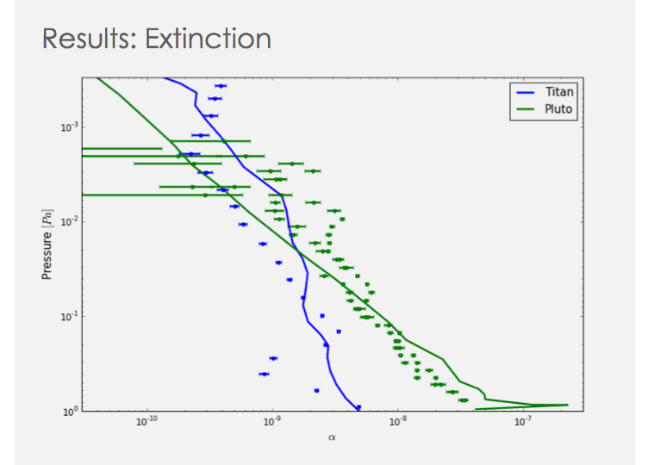
Wong et al. 2016
Gao et al. 2016

Slide 27
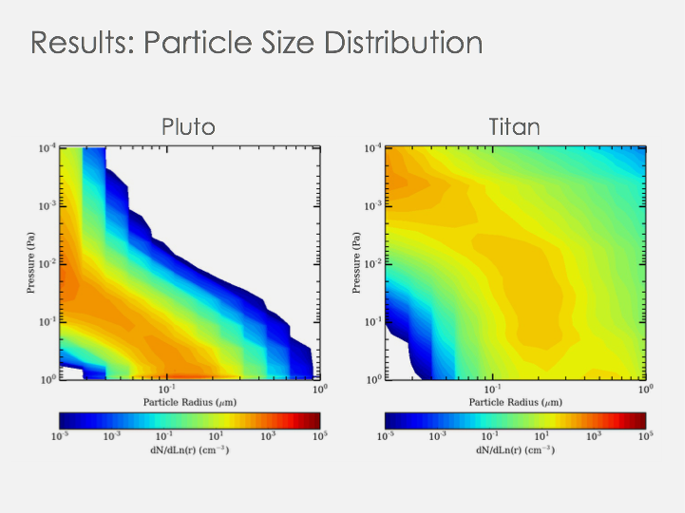

Slide 28
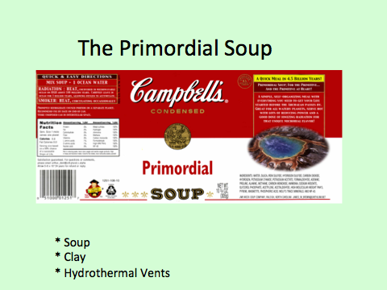

Slide 29
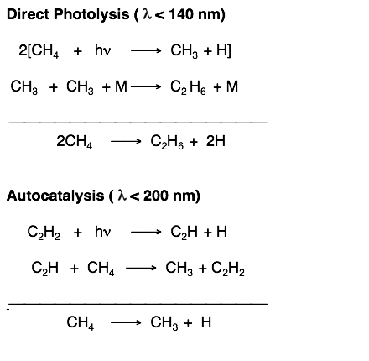


Autocatalysis
Allen, Pinto and Yung 1982

Slide 30
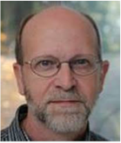
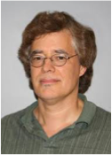
Randy Gladstone
& Mike Summers
Is Pluto a Proxy for Snowball Titan?
Outstanding Issues
Jim Lyons
Is Triton more similar to Pluto than to Titan?
Lyons, Allen and Yung 1992

Slide 31
Outstanding Issues
  Abiotic Organic Synthesis

Slide 32
Today’s Outline
Introduction
Terrestrial Planets: Mars, Earth, Venus
Terrestrial Analogs: Titan, Pluto,Triton
Exoplanets and Life

Slide 33
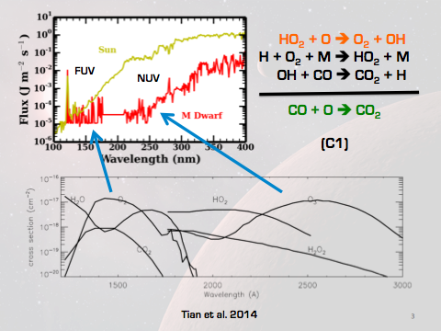
ExoMars
Gao et al. 2015

Slide 34
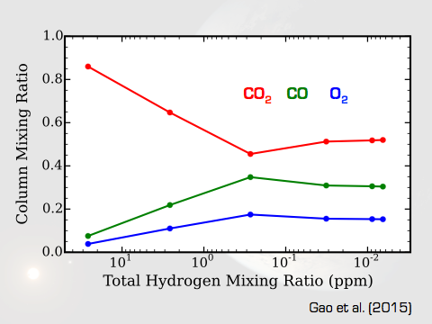

Slide 35
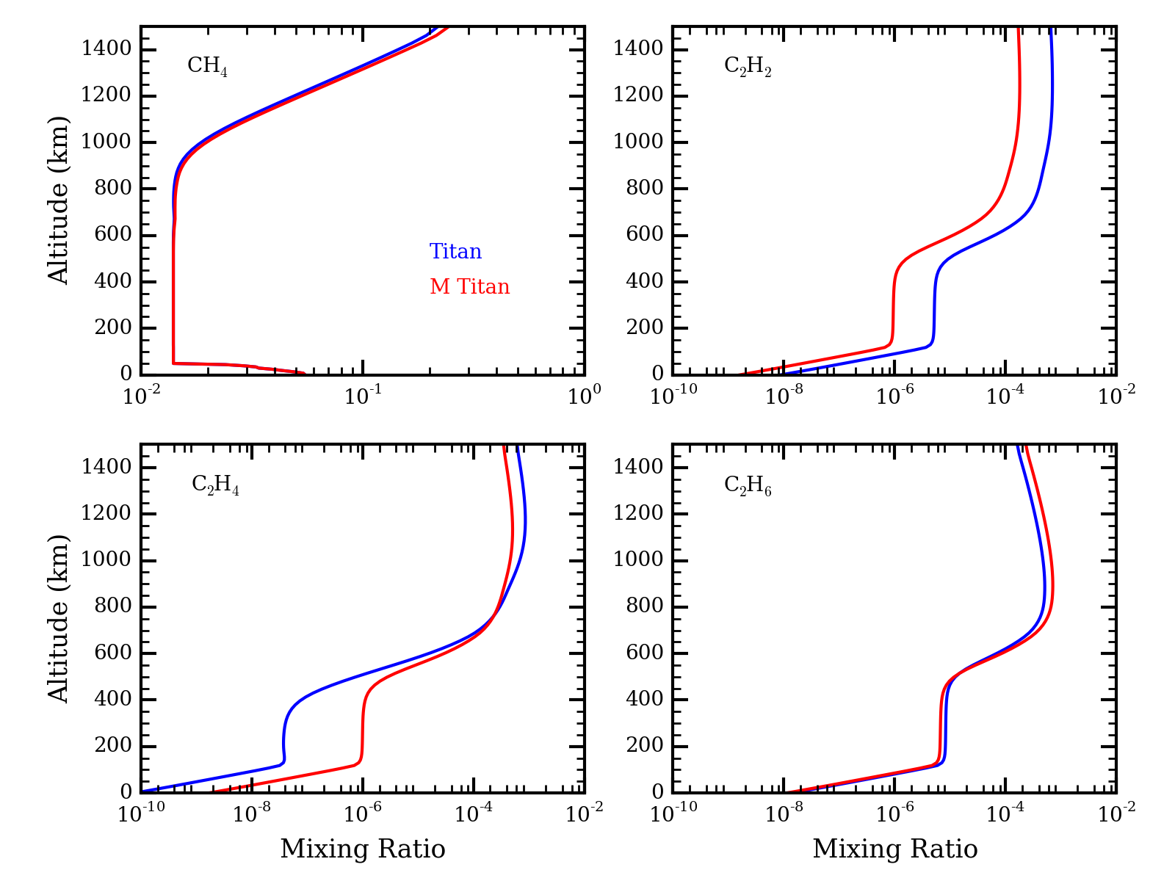
ExoTitan
Gao and Yung (2016)

Slide 36
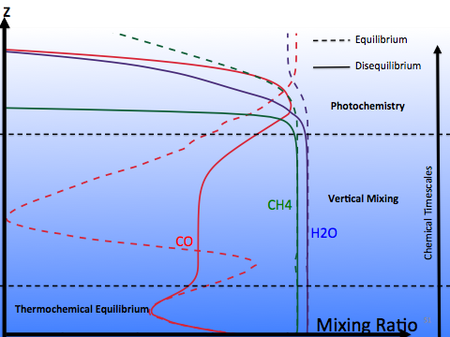

Hot Jupiters: Equilibrium and Disequilibrium Chemistry
Mike Line
Exoplanet like HD189733b

Slide 37
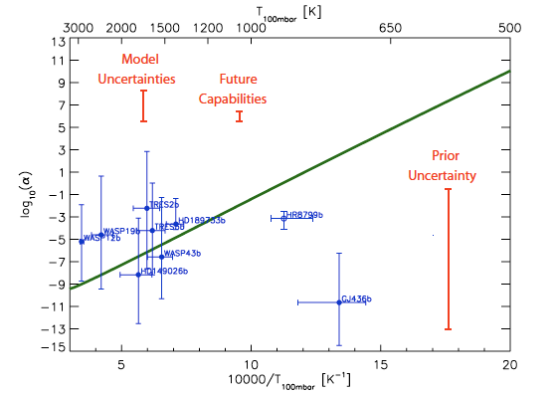
Line and Yung
(2013)
Test of Equilibrium Chemistry

Slide 38
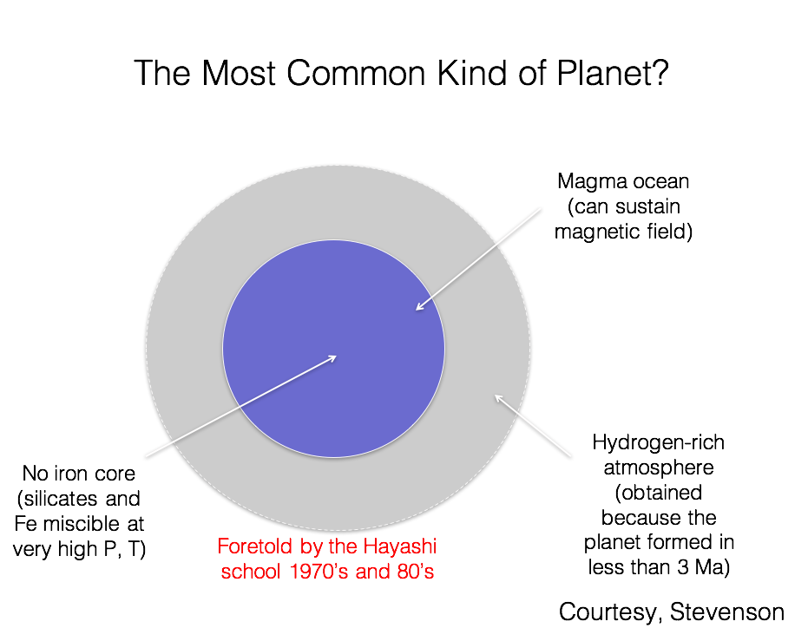

Slide 39
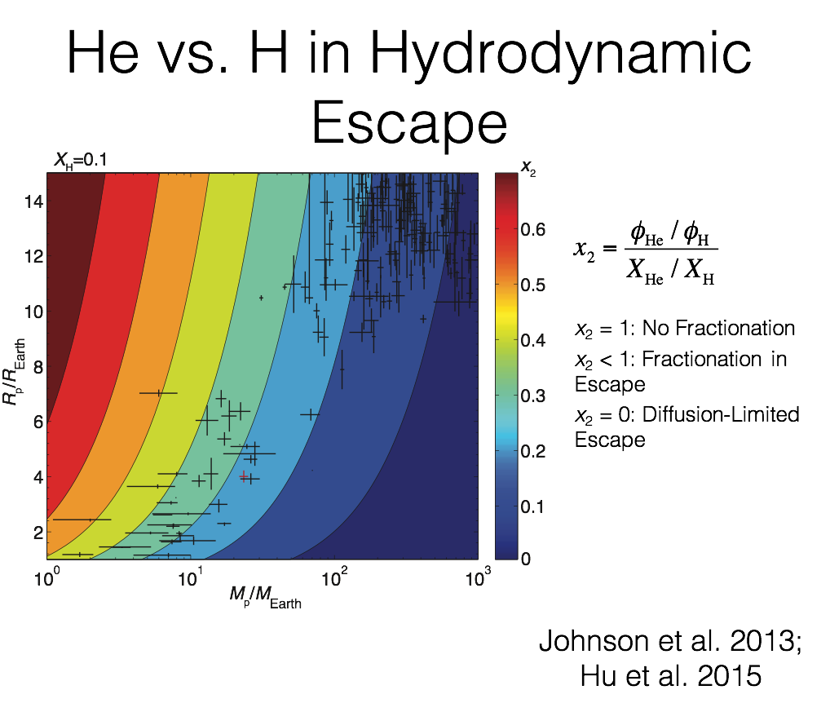

Slide 40
Outstanding Issues
  Biosignature

Slide 41
Today’s Outline
Introduction
Terrestrial Planets: Mars, Earth, Venus
Terrestrial Analogs: Titan, Pluto,Triton
Exoplanets and Life

Slide 42
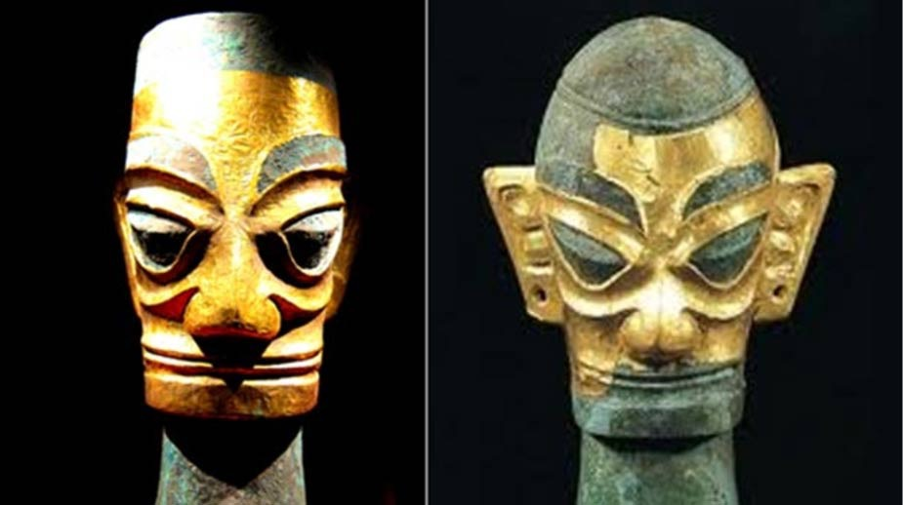
Outstanding Issue:
Are we alone?
Sanxingdui Museum Sichuan, China

Slide 43
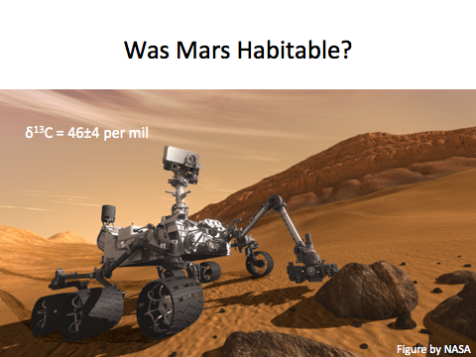
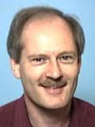
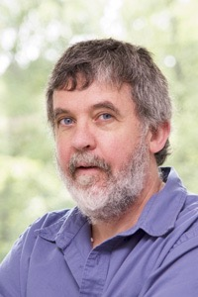
Chris Webster
Paul Mahaffy

Slide 44

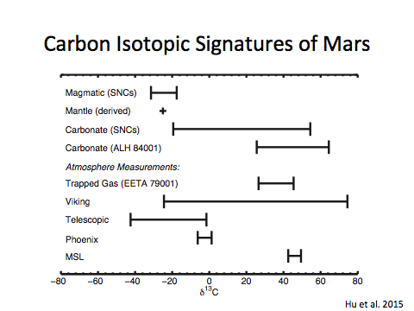
Renyu Hu
Hubble Fellow
JPL Scientist

Slide 45
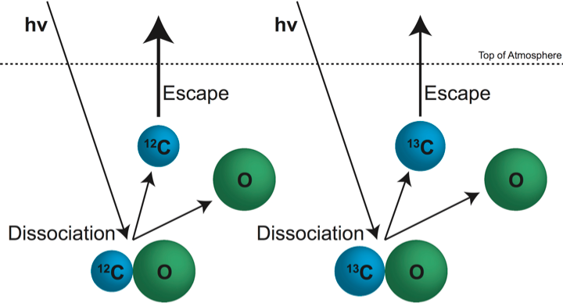
Carbon Escape via CO Photodissociation
Hu, Kass, Ehlmann and Yung 2015

Slide 46
A Moderately Dense
Early Atmosphere
An upper limit of 0.9 bar can be derived from when carbonate formed in the subsurface
Or 1.7 bar when carbonate in surface lakes
The atmosphere does not collapse, allowing transient melting, runoff, and low-temperature hydrological cycles
Forget et al. 2013; Kite et al. 2014; Hu et al. 2015

Slide 47
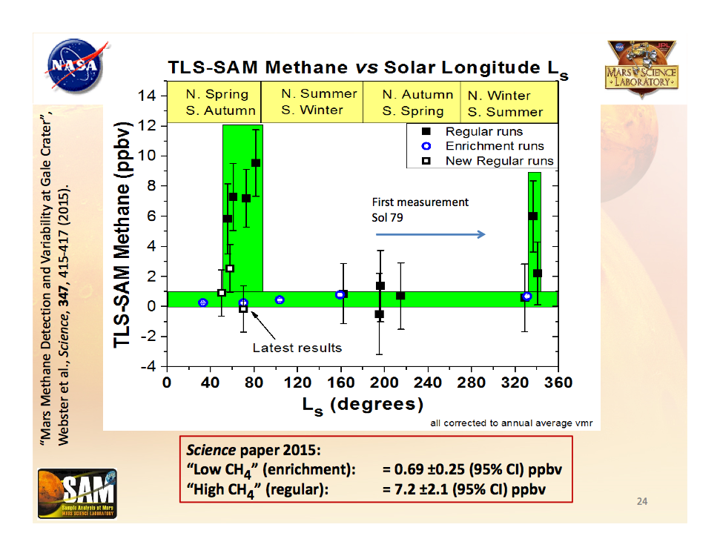

Slide 48
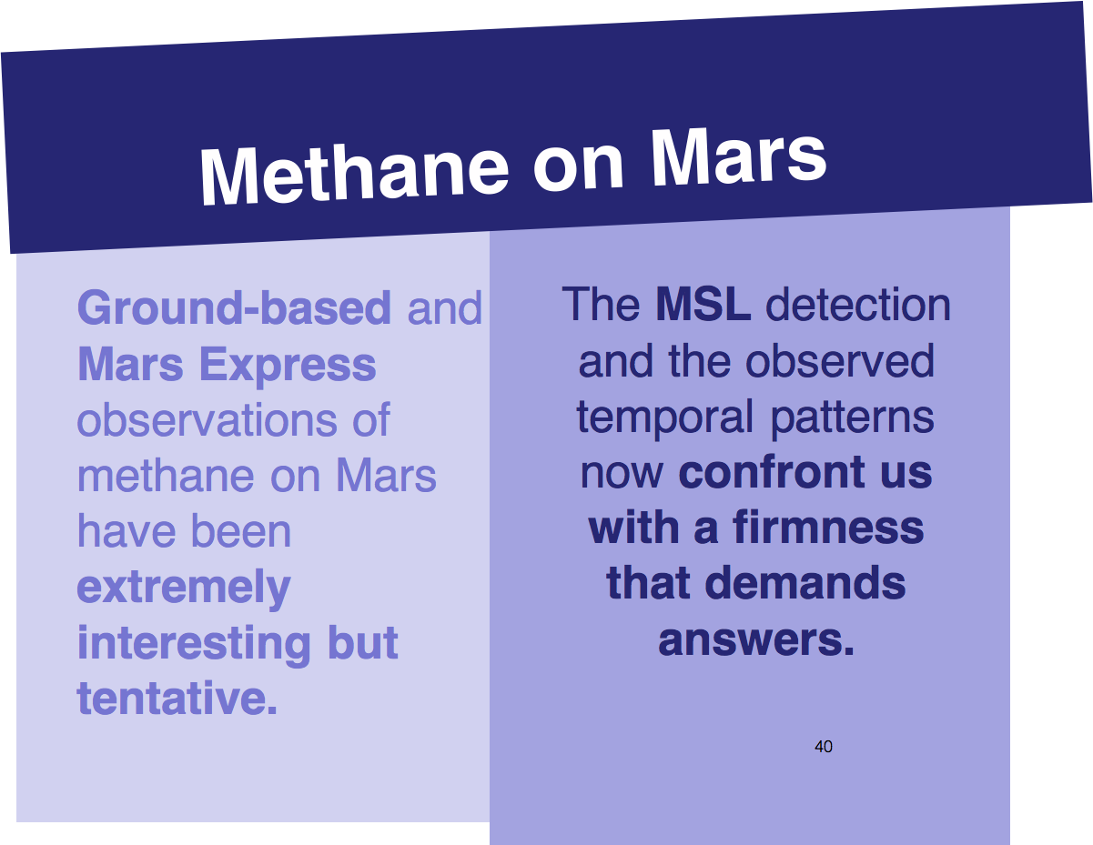

Slide 49
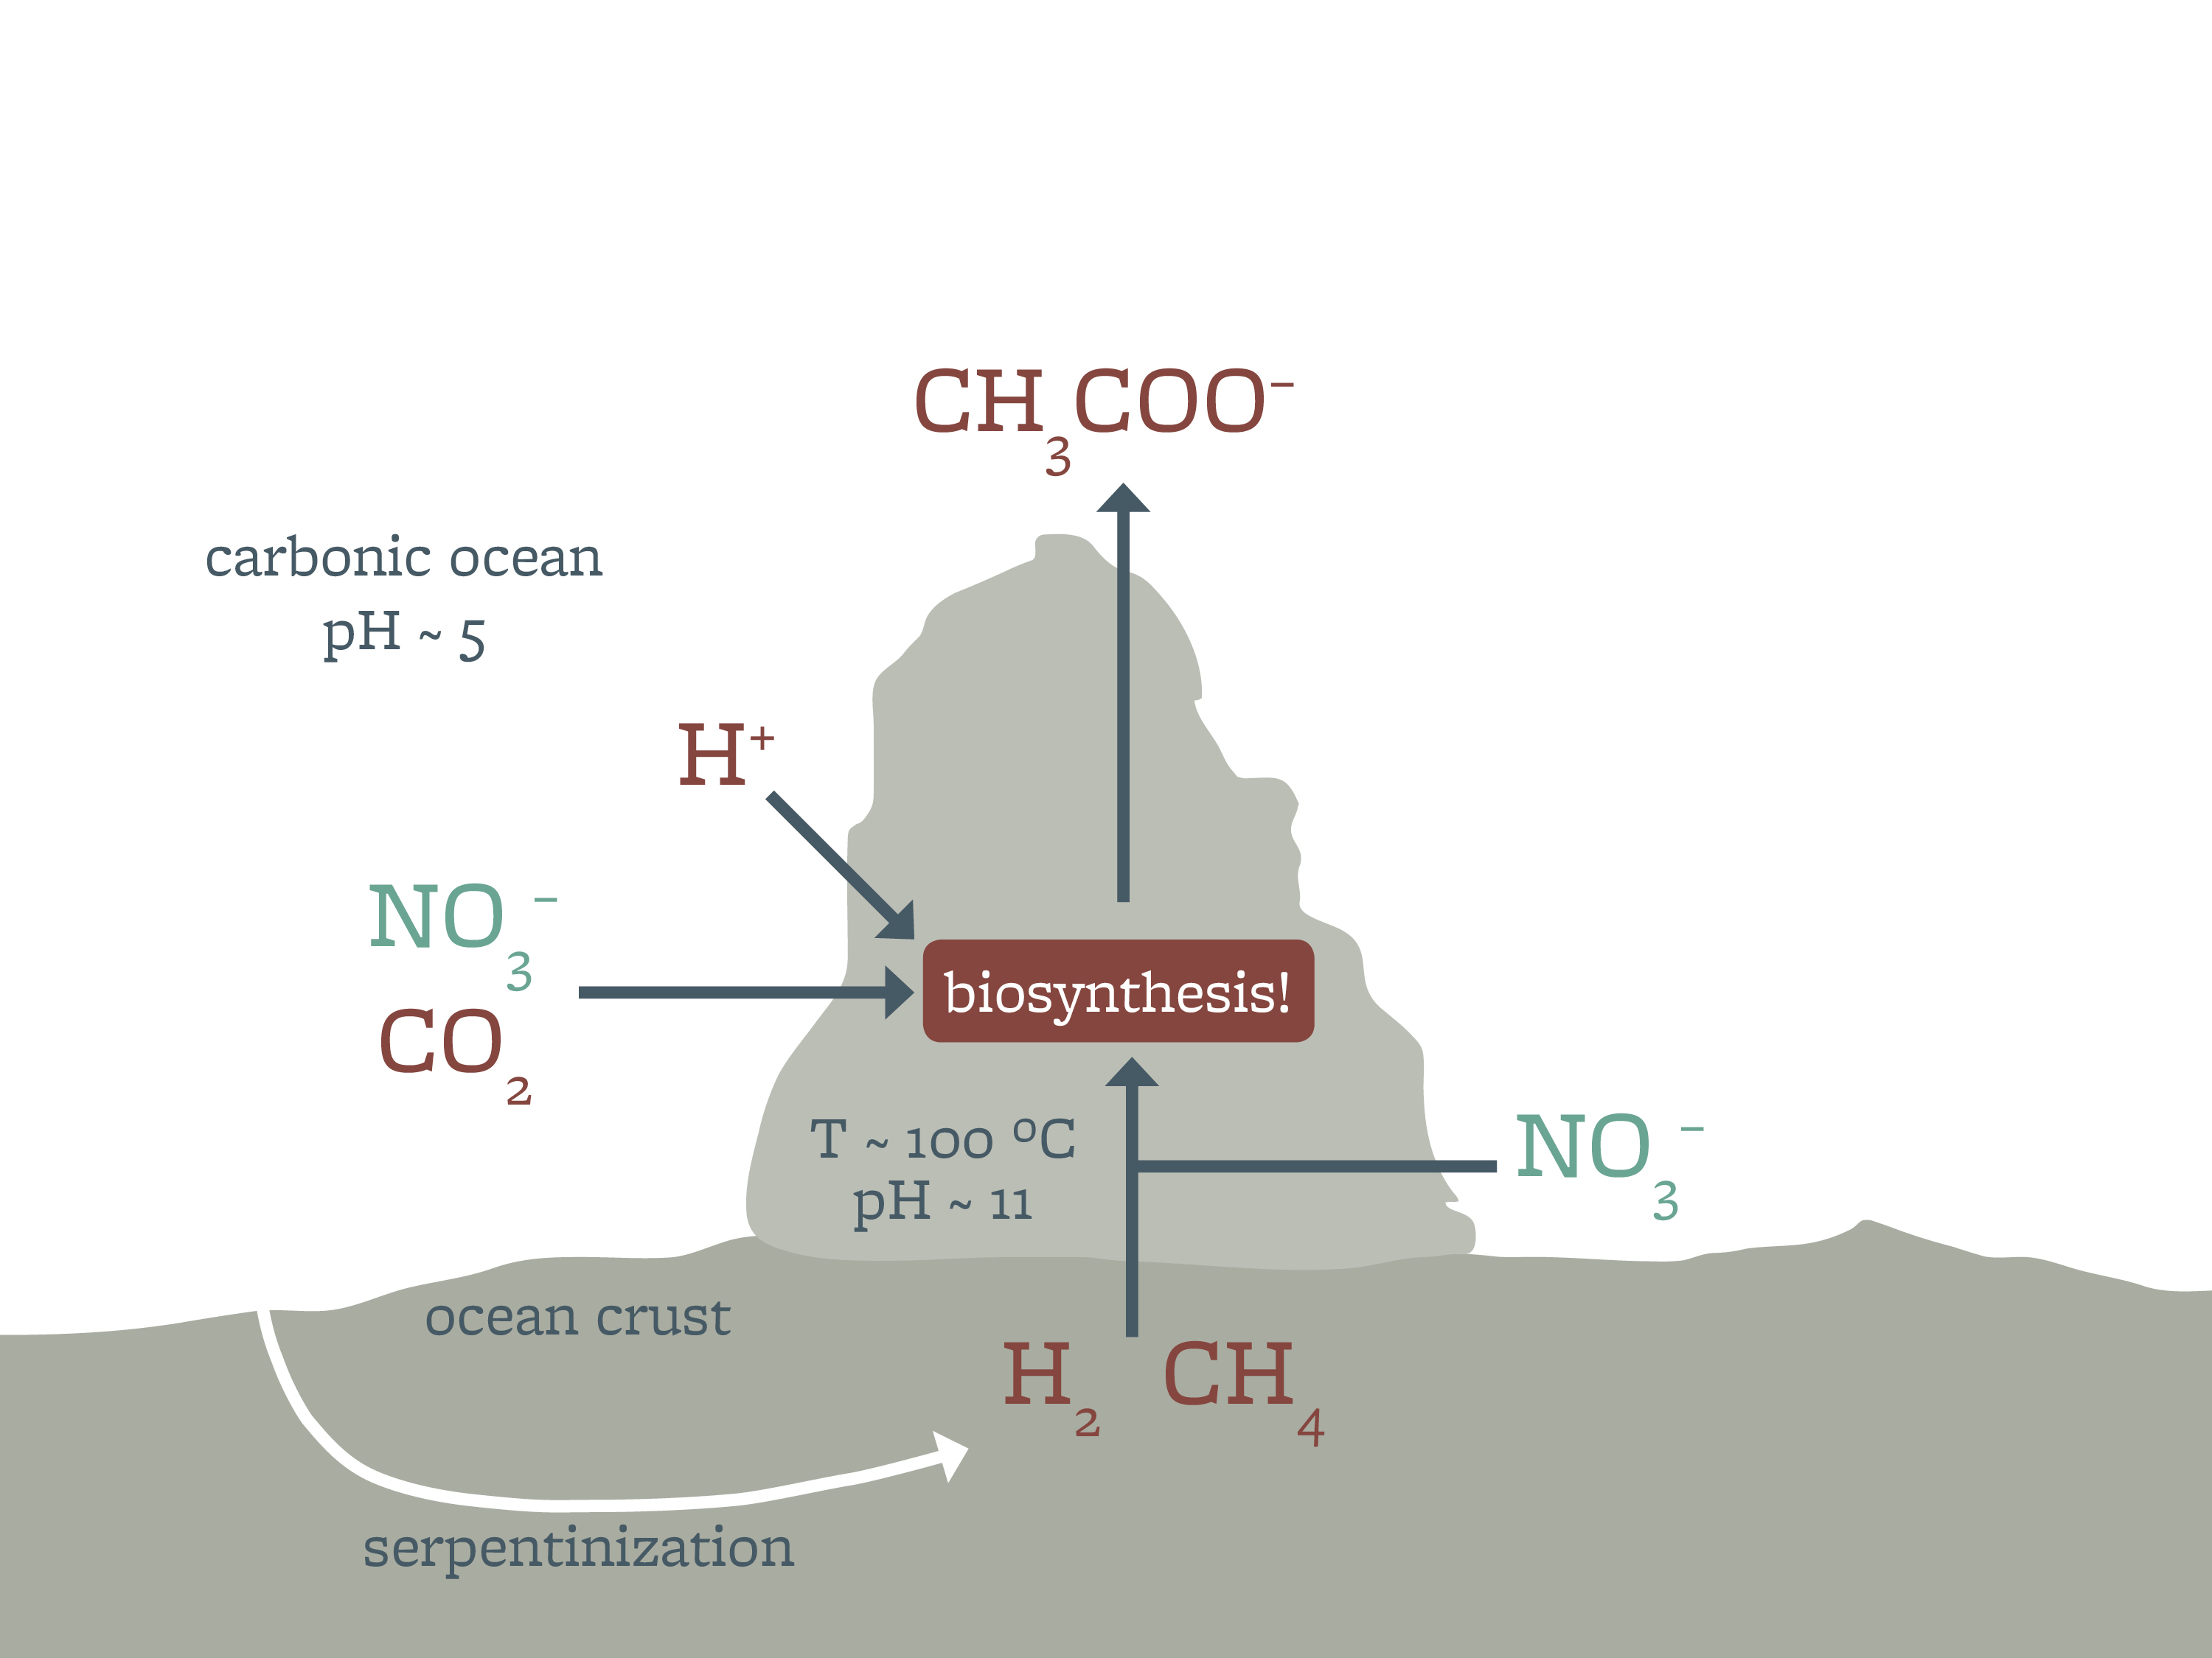
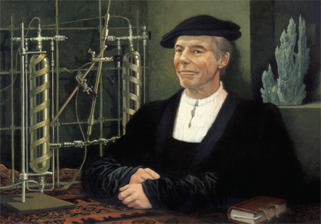

How did Life Start on Earth?
Russell et al. 2014
Michael L. Wong

Slide 50

Emergence of Life is Ineluctable on a Habitable Planet!
Wong, Russell, Charnay, Yung 2016, In Review

Slide 51


Slide 52

“
Twenty-first century astronomers are
uniquely positioned
to study the evolution of the Universe in order to relate causally the physical conditions during the Big Bang to the development of RNA and DNA.
—Riccardo Giacconi
Nobel Prize in Physics, 2002

Slide 53

Photo Credit: Brandon Carroll

Slide 54


Slide 55


Slide 56

Outstanding Issues

Slide 57


Slide 58
Backup Slides

